Slide 1
KLEIT INCUBATE IND HACKATHON
Topic: Health
Naveed Choudhary
V Chiranjeevi
Nagesh Shidling

Slide 2
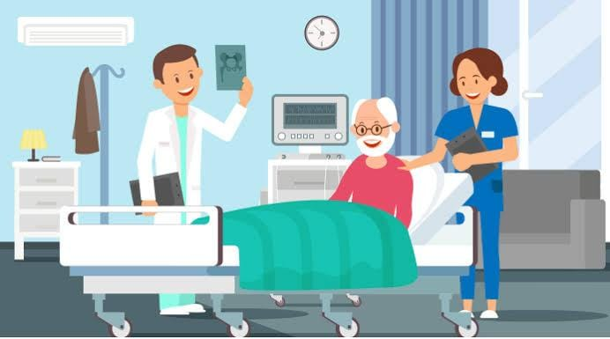
Whenever any patient visits hospital, Doctor gives medical prescription to the patient

Slide 3
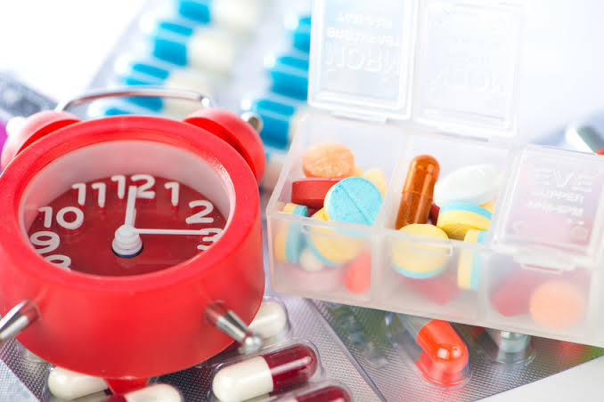
Take medicine on times is very important

Slide 4
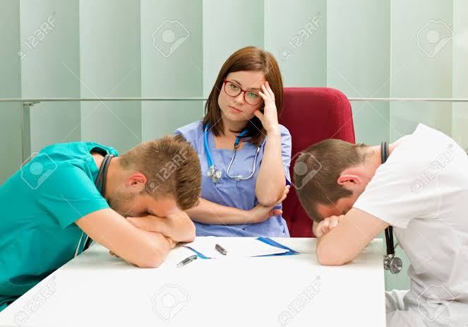
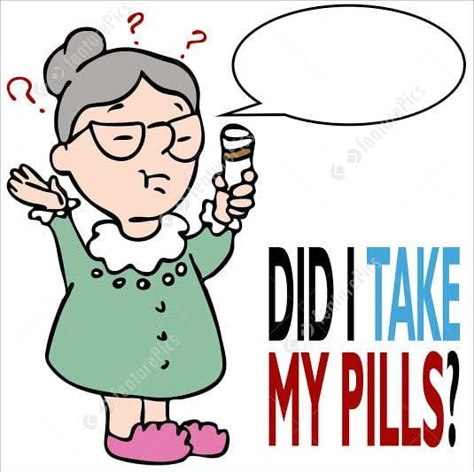
It is difficult to remember the pescription schedule, So patients find it tedious to take the prescribed medicine.

Slide 5
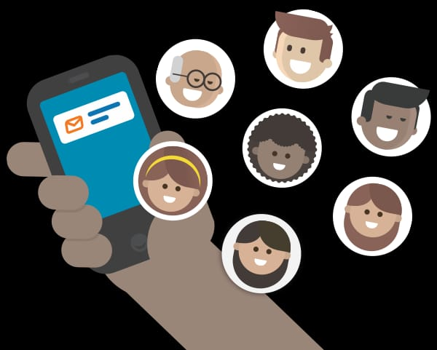
So, to avoid this problem we shall introduce a web app by which patients will observe the prescription in their cell phone, Then it would become easier to remember the prescription for patients .

Slide 6
Thank you

